Slide 1


Group 3
Stock Price Prediction Using Statistical Methods
BY IMPLEMENTING 5 TIME SERIES MODELS
1 st Khoa Le Tri
20521466@gm.uit.edu.vn
2nd Huy Lam Le Phuc 20521388@gm.uit.edu.vn
3rd Thien Nguyen Huu 20521951@gm.uit.edu.vn

Slide 2

TIME SERIES MODELS IN USE
LNR
NLR
ARIMA
Linear Regression Model
Nonlinear Regression Model
Autoregressive Integrated Moving Average Model
LSTM
PROPHET
Long Short-Term Memory Model
Prophet Model

Slide 3
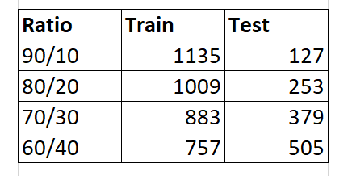
Data Information
Data Set
Number of Observation
VinaCapital Vietnam Opportunity Fund Limited (VOF.L) index for the period between
12/28/2017 - 12/23/2022 from the Yahoo finance Website.
The data set consists of 1262 observations.
Data Set Is Split Into Two subsets: Training & Test Datasets
Where we also divide in 4 different ratio: 90/10, 80/20, 70/30 & 60/40.

Slide 4
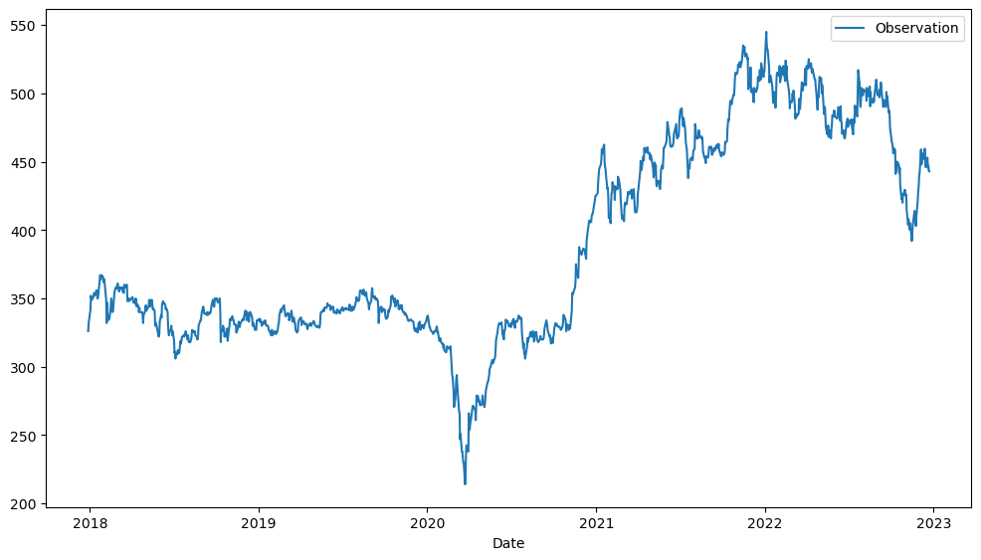
Visualization of Data Set

Slide 5
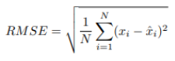
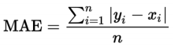
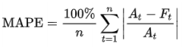
Assessment Metric Used
RMSE
MAE
MAPE
Root-Mean-Square Error is a measure frequently used for assessing the accuracy of prediction obtained
by a model.
Mean Absolute Error is a measure of errors between paired observations expressing the same phenomenon.
The Mean Absolute Percentage error is a measure
of prediction accuracy of a forecasting method in statistics.

Slide 6
Regression
Linear Regression Model
Linear regression
- A linear approach for modelling the relationship between a scalar response and one or more explanatory variables.
- Linear regression model follows a very particular form: a regression model is linear when all terms in the model have a constant or a parameter multiplied by an independent variable.
- Buy adding the terms together, the equation is formed:
Where Y is a dependent variable, X are independent variables,
Βi is the parameter
and ϵ are errors.

Slide 7
Regression
Nonlinear Regression Model
Nonlinear regression
- A form of regression analysis in which observational data are modeled by a function which is a nonlinear combination of the model parameters and depends on one or more independent variables.
- In statistic, nonlinear regression can be demonstrated by the
equation:
Where X is a vector of P predictors, β is a vector of k parameters,
F is the known regression function.

Slide 8

ARIMA
Autoregressive Integrated Moving Average
- A generalized model of Autoregressive Moving
Average (ARMA) that combines Autoregressive (AR) process
and Moving Average (MA).
- As the acronym indicates, ARIMA (p, d, q) captures the key elements of the model:
AR: Autoregression
I: Integrated
MA:
Moving Average
Forecast a series based solely on the past values in the series – called lags (p).
Make the time series stationary by
measuring the differences of observations at different time (d).
Forecast a series solely on the past errors in the series – called error lags (q).

Slide 9
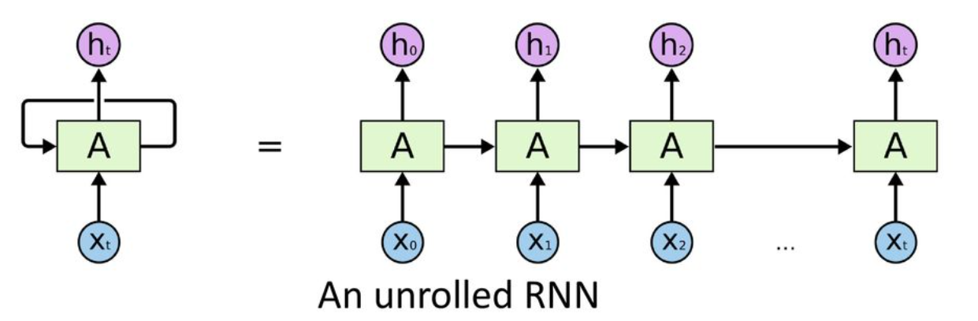
LSTM
Long Short-Term Memory
RNN
Problem with RNN
- Recurrent Neural Network (RNN) is a type of neural network main works on time series data.
- It has internal/hidden states to process the input sequence.
- Output of a previous time step is also used in the next time step
- Long-term dependencies not captures, as the number of time steps increase, the RNN is unable to connect information.
- Vanish gradient causes loss of long-term memory, while emphasizing short term

Slide 10
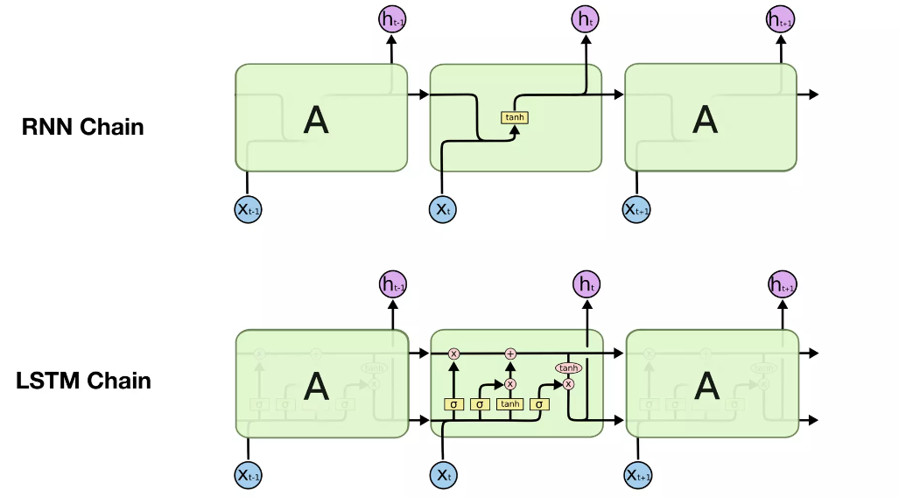
LSTM
Long Short-Term Memory
How do LSTMs work?
- LSTMs try to add long term memory to remember certain hidden states more than others. This allows them to retain knowledge over longer sequence
- They have 2 outputs instead of 1, the hidden state and the cell state

Slide 11
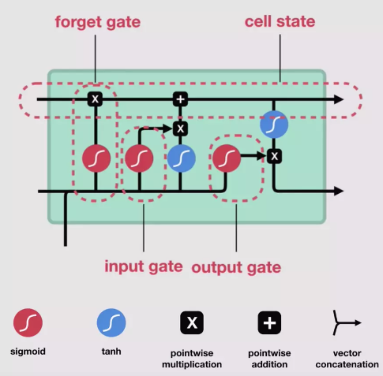
LSTM
Long Short-Term Memory
LSTM cell architecture
- Cell state is a channel that runs along the LSTM chain carrying information from one time-step to another freely.
- LSTM architecture consists of 3 Gates which control the flow of information into and out of the cell.
f: Forget gate, Whether to erase cell
i: Input gate, whether to write cell
o: Output gate, How much to reveal cell

Slide 12
PROPHET
Facebook Prophet Model
- Introduced by Facebook (Taylor & Letham in2018)
- Used for forecasting univariate time series by decomposing the series into pieces – similar to exponential smoothing.
- The prophet structure consists of 3 components:
Growth/Trend
Seasonality
Holiday
Piecewise linear or logistic growth curve for modeling non-periodic changes in time series
Periodic changes (e.g. weekly/ yearly seasonality)
Effect of holidays (user provided) with irregular schedules)

Slide 13

WORKSHOP
QR link for demo tests:
https://drive.google.com/drive/folders/1z9Ums3HTcPMJX1AEwMnq10Jic4VcrSg7?usp=sharing

Slide 14

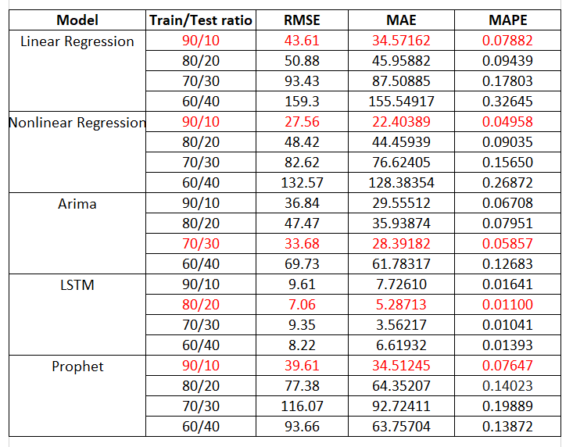
RESULT
Performance Review: ACCURACY VALUES FOR ALL MODELS

Slide 15
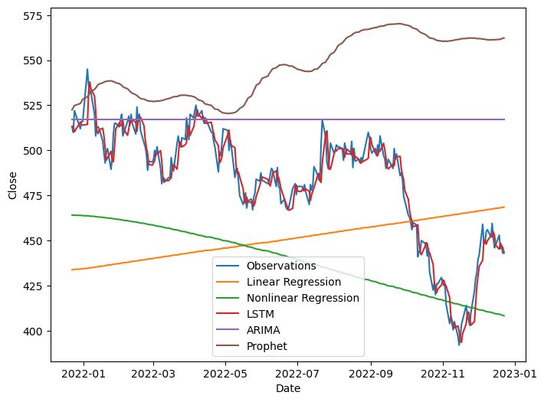
RESULT
20% Test Forecasting

Slide 16
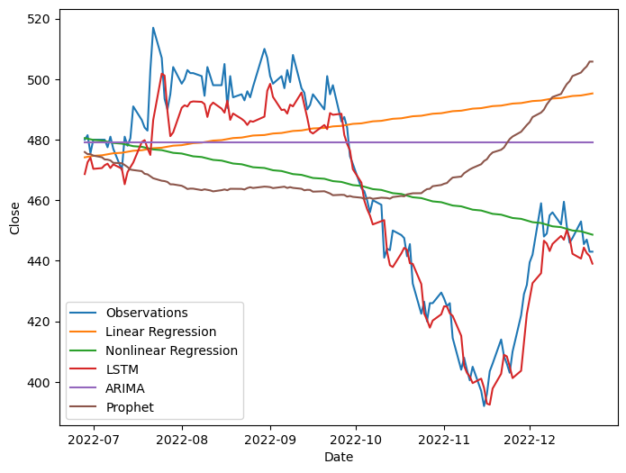
RESULT
10% Test Forecasting

Slide 17
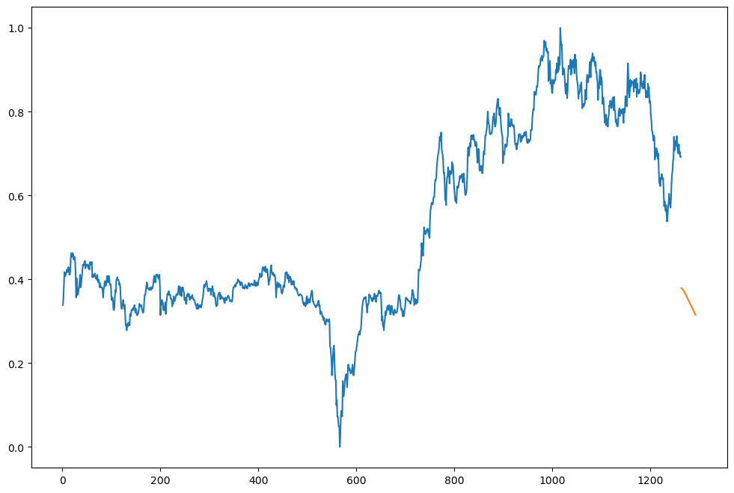
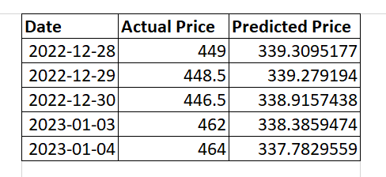
Practical use of LSTM
We used the 80/20 trained LSTM model to predict the next 30 days that is not included in the data.
From from 24/12/2022 to 4/1/2023, there are only 5 entries for the VOF.L on the Yahoo finance.:

Slide 18
Group 3
Thank You
danke schön
merci
ありがとう
For Your Attention !

